Slide 1





LLM-driven Multimodal Target Volume Contouring in Radiation Oncology
25.06.11
www.mi2rl.co

Slide 2
Introduction
AI models have focused on individual data modalities (visual or linguistic).
Physicians rely on both imaging studies and textual electronic medical data for decision-making.
Multimodal AI understands diverse data types and their interrelationships, providing a comprehensive view of data.
Two critical components are needed in Intensity-Modulated Radiation Therapy (IMRT)
Organs-at-risk (OARs): radiosensitive organs susceptible to damage by ionizing radiation during RT
Target volume where the dose is prescribed.
Planning CT images + Clinical information
crucial for treatment planning (responsibility of experienced radiation oncologists)
Previous segmentation models have conspicuous gap in research persists
Tumor stage, Histological diagnosis, Extent of metastasis, Gene mutation, Patient’s status, Age
High risk metastatic growth areas are treated electively by understanding of various data modalities
→ necessity to incorporate textual clinical data
Recent LLMs discern relationships among varied data types, generate new data from learned patterns
Multimodal can be integrated into LLMs through adaptors and generative models for generation

Slide 3
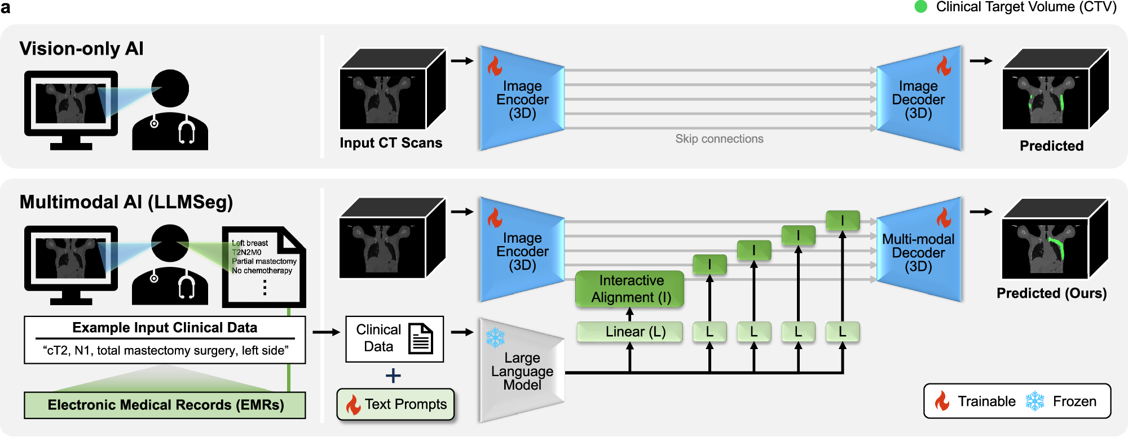
Introduction
This study present 3D multimodal clinical target volume delineation model by integrating clinical information through the LLM for conditioning a segmentation model.
Integrated textual information from well-trained LLMs through simple prompt tuning
Interactive alignment use both self-attention and cross-attention in a bidirectional manner (text2img, img2text)
Layer-wise MM features are combined to jointly predict the target labels through the MM decoder.
Light-weight learnable text prompts leverage linguistic capability of the LLM within the proposed MM AI framework.

Slide 4
M&M
Schematic Comparison of the Workflows of Radiology and Radiation Oncology
Radiology heavily relying on the visual information of the current imaging study
Radiation oncology relies more on patient’s history, pre- and post-operative imaging results, surgical pathology findings, laboratory results, and other clinical information
Definition of Task
Gross Tumor Volume (GTV): visible tumor
Clinical Target Volume (CTV): includes regions prone to microscopic disease
tumor type, histological findings, cancer stage (TNM classification), patient age, and performance status
Planning Target Volume (PTV): expands CTV to include margins for uncertainties in patient setup and positioning
Ex) Breast cancer
Stage 1 with no regional lymph nodes (LN) metastasis: whole breast
Stage 3B with regional LN metastasis: need for elective nodal irradiation across all regional nodal areas

Slide 5
M&M
Details of Clinical Target Volume
- Breast Cancer
Early breast cancer (Tis-T2) without nodal metastasis at initial diagnosis: whole breast
Breast cancer with nodal metastasis (T3-4), T2 with adverse features: regional node irradiation
N2 or more nodal metastasis: Radiation Therapy Oncology Group (RTOG) guidelines
N1 or less nodal involvement: European Society for Radiotherapy and Oncology (ESTRO) guidelines
- Prostate Cancer
pelvic LN: regional node irradiation was performed with prostate bed radiation
elective nodal irradiation on the pelvic LNs: National Comprehensive Cancer Network risk groups
T stage, Prostate-Specific Antigen (PSA) levels, and Gleason score
Individuals aged 80 and over: omission of pelvic LN irradiation.
Seminal vesicle invasion: contouring include the prostate and extend to the seminal vesicles.

Slide 6
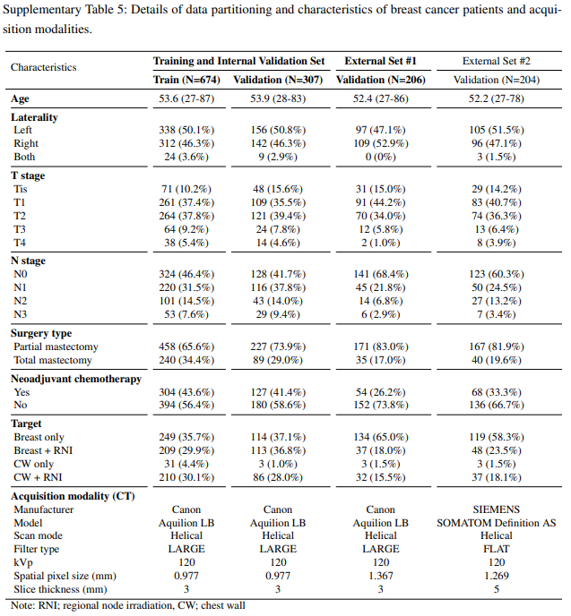
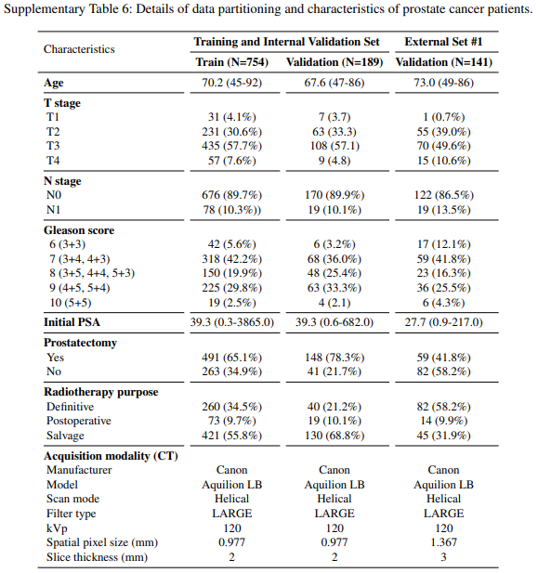
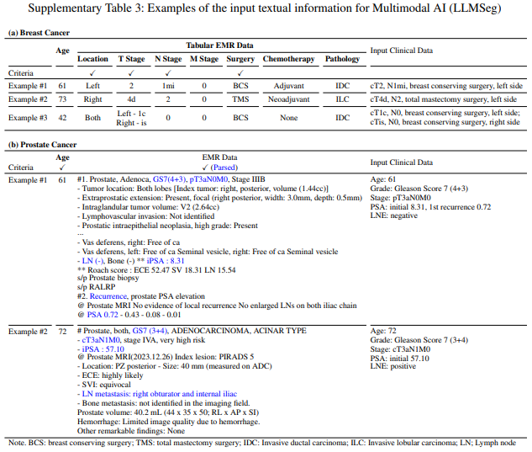
M&M
Details of Datasets
Patients with breast cancer and underwent radiation therapy post-curative surgery
연세암센터: 981 case
용인세브란스병원: 206 case
강남세브란스병원: 204 case
Patients with prostate cancer
연세암센터 : 943 case
용인세브란스병원 : 141 case
Text-based Clinical Information
Location of the primary cancer, type of surgery undertaken, disease stage, and the status of nodal metastasis
Breast cancer: tabular format derived from raw clinical data
Prostate cancer: input clinical information from EMR data (10-shot in-context learning strategy with a pre-trained LLM)

Slide 7
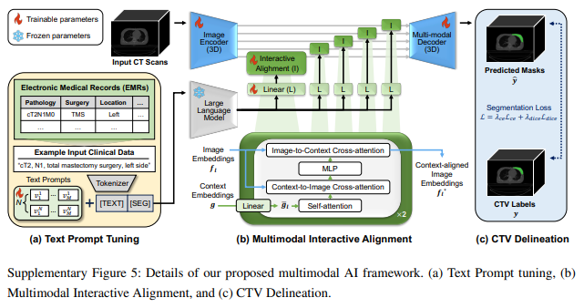
M&M
Details of Implementation
Image encoder/decoder: 3D Res U-Net
LLM: Llama2-7B-chat model
Interactive Alignment: two-way transformer of SAM
3 key components:
Text prompt tuning
Multimodal interactive alignment
CTV delineation

Slide 8
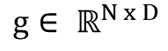
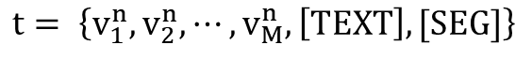
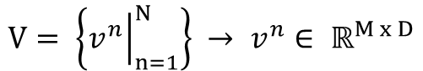
M&M
Details of Implementation
Text prompt tuning
N-text prompts:
N: # of text-prompts
M: # of text embedding per prompt (8)
D: Embedding dimension of LLM (4096)
Learnable vectors are prepended to each of tokenized clinical data ([TEXT] tokens):
Append a token intended to attend to all the aforementioned vectors and tokens ([SEG]):
Final prompted text input:
Inputted [SEG] token’s output embeddings from frozen LLM: context embeddings
$$V= \left\{{\left.v^{n}\right|}_{n=1}^{N}\right\} → v^{n}∈ ℝ^{M x D}$$
$$t= \left\{v_{1}^{n},v_{2}^{n},⋯,v_{M}^{n},\left[TEXT\right], [SEG]\right\}$$
$$g∈ ℝ^{N x D}$$

Slide 9
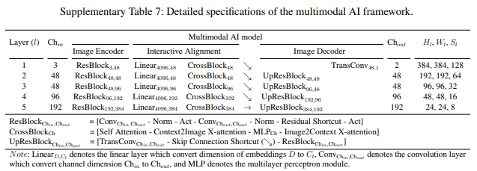
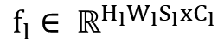
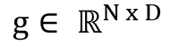
M&M
Details of Implementation
(b) Multimodal Interactive Alignment
context embeddings:
image embeddings:
f_{l}: l-th layer output of the 3D image enconder
H_{l}, W_{l}, S_{l}: height, width, slice of image embeddings
C_{l}: intermediate channel dim of l-th layer output
Project g to have identical dim with that of each f_{l} through layer-wise linear layer
Linearly projected context embeddings g_{l} are self-attended and crossly-attended with image embedding f_{l} to result context-aligned image embeddings f_{l}*
$$g∈ ℝ^{N x D}$$
$$f_{l}∈ ℝ^{H_{l}W_{l}S_{l}xC_{l}}$$

Slide 10
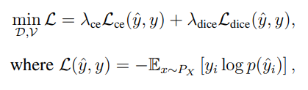
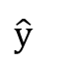
M&M
Details of Implementation
(c) CTV Delineation
image embeddings: f_{l}*
→ final predicted output:
Loss: CE + Dice Loss
$$\hat{y}$$

Slide 11
M&M
Details of Network Training
Resampling:
Voxel spacing: 1 * 1 * 3 mm
HU Clipping: -1,000 ~ 1,000 + min-max norm
3D patch size: 384 x 384 x 128
Batch size: 2
Optimizer: AdamW, 0.0001
Epoch: 100
GPU: RTX A6000 48GB
Model
Frozen: LLM
Trainable: Image encoder/decoder, interactive alignment, linear layers, text prompts
Details of Evaluation
Dice coefficient (Dice), Intersection over Union (IOU), 95th percentile of Hausdorff Distance (95-HD)

Slide 12
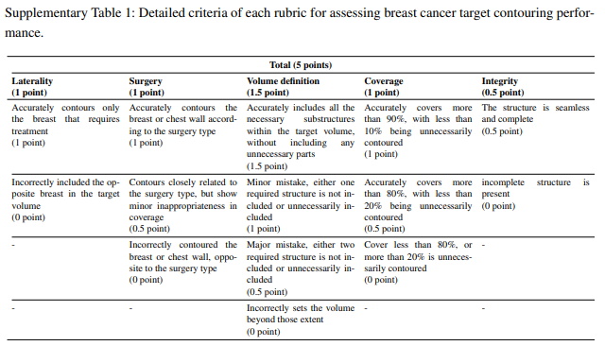
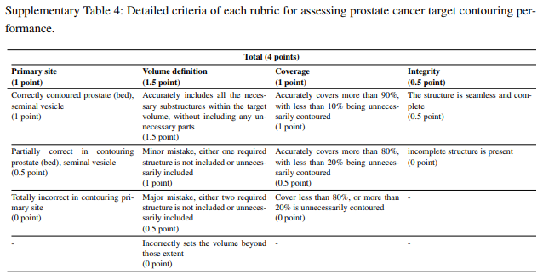
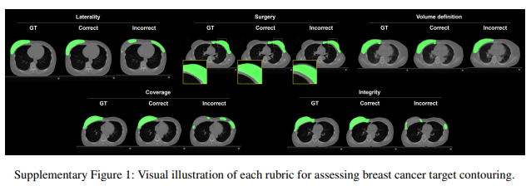
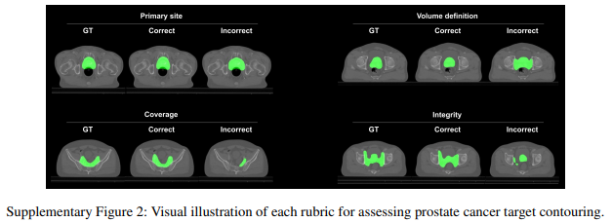
M&M
Details of Clinical Evaluation
Breast Cancer: laterality, type of surgery, volume definition, coverage, integrity
Prostate Cancer: primary site, volume definition, coverage, integrity

Slide 13
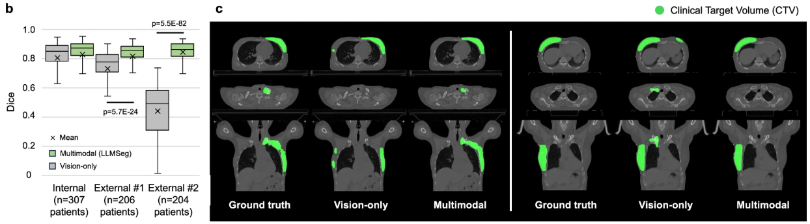
Results
Accurate and Robust CTV Delineation Performance and Multimodal Model
Internal: over 0.8
External1 & 2: 0.73 and 0.44
External2 (manufacturer differ): vision-only model completely failed to perform CTV delineation
(Left) GT: CTV on both the breast and regional LNs / Vision: breast alone
(Right) GT: early breast cancer case requiring treatment of the breast only / Vision: includes regional LN

Slide 14
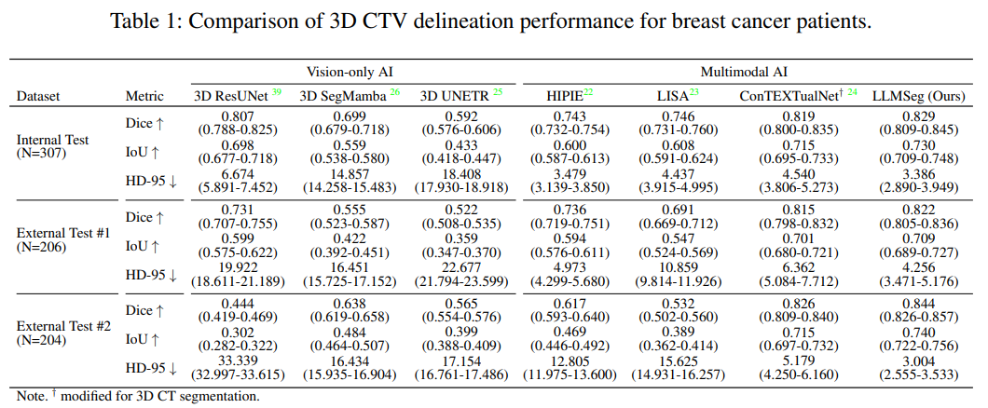
Results
Accurate and Robust CTV Delineation Performance and Multimodal Model
Vision-only SOTA: 3D ResUNet
HIPIE: 2D referring segmentation / LISA: 2D reasoning segmentation / ConTEXTualNet: 3D image
Multimodal SOTA: LLMSeg (Ours)

Slide 15
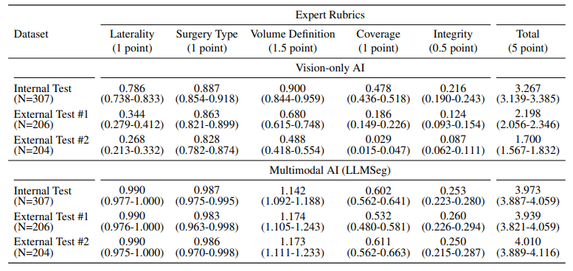
Results
Performance Evaluation by Expert Reveals Superiority of Multimodal Model
Target volume should base on appropriate clinical rationale
contoured on the treated side of the breast / type of surgery / regional LNs
evaluated by a board-certified radiation oncologist
multimodal model achieved total scores up to twice as high as those of the vision-only model
MM model exhibited notably larger gains in rubrics of laterality and volume definition

Slide 16
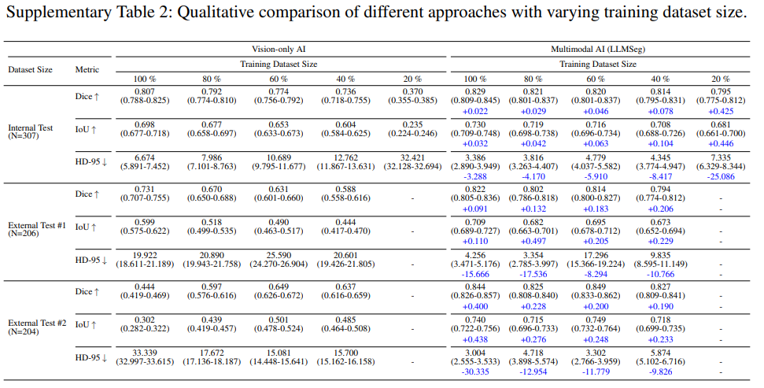
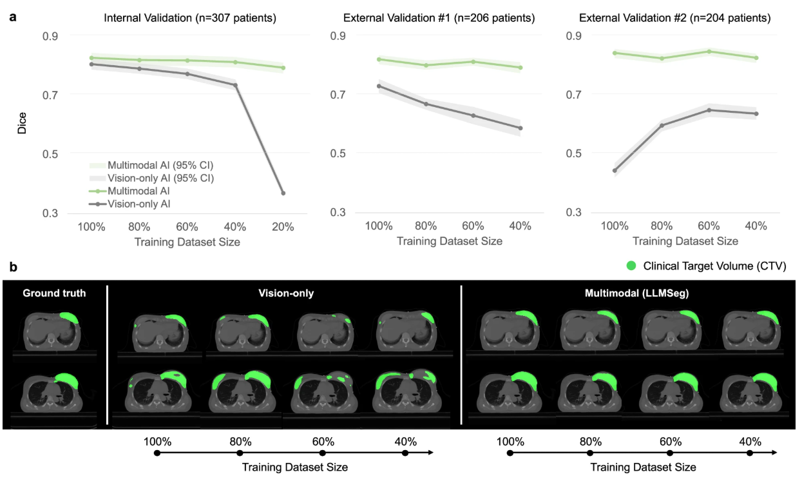
Results
Data Efficiency and Robustness of the Multimodal Model
(40% Data) MM: over 0.8 / Vision: 0.7
(20% Data) MM: slightly below 0.8 / Vision: failed to contour CTV
External2: notable overfitting on vision-only model

Slide 17
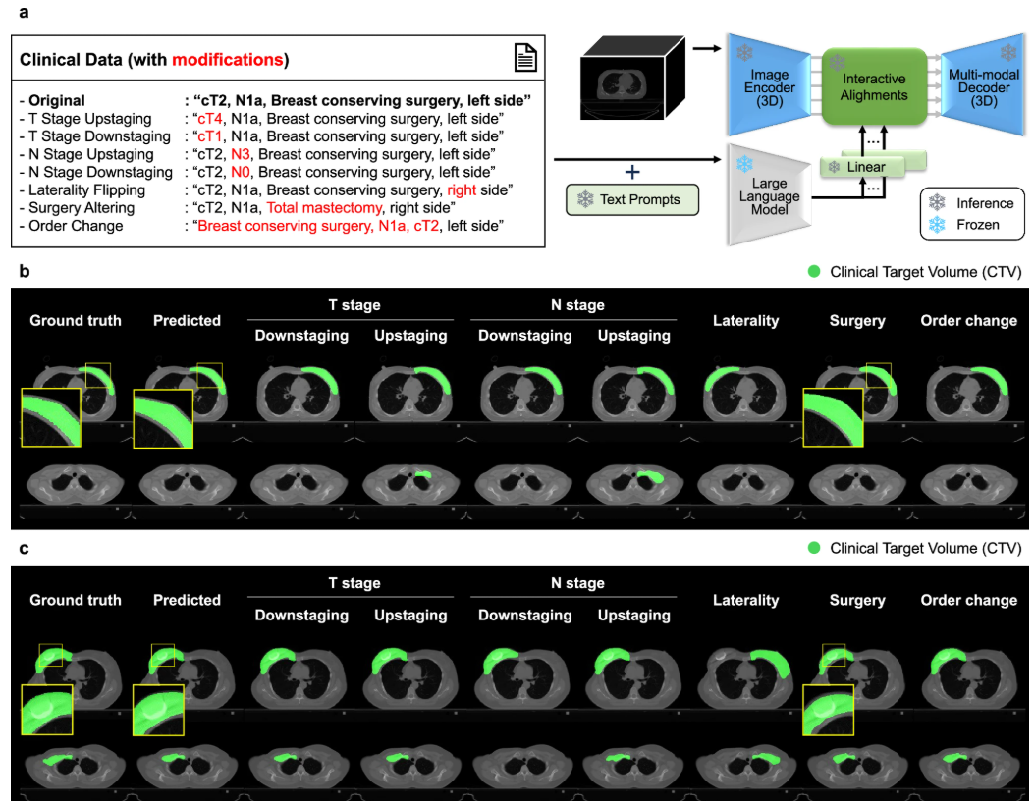
Results
Differential Target contouring Based on Varied Textual Inputs
T: Tumor (종양의 크기 및 침윤 정도) - 암이 어디까지 퍼졌는가
T0: 종양 없음
Tis: 상피내암 (in situ, 아직 퍼지지 않은 초기 단계)
T1~T4: 종양 크기 또는 침범 정도에 따라 단계 구분 (숫자 커질수록 크기 ↑)
N: Node (림프절 전이 여부) - 주변 림프절에 암세포가 퍼졌는지 여부
N0: 림프절 전이 X
N1~N3: 전이된 림프절의 수, 위치, 범위에 따라 구분 (숫자 커질수록 전이 ↑)
a: 국소(중심부분) 림프절 전이 / b: 원격(외측) 림프절 전이
M: Metastasis (원격 전이 여부) - 다른 장기나 분위로 암이 전이되었는지 여부
M0: 원격 전이 X
M1: 원격 전이 O

Slide 18
Results
Differential Target contouring Based on Varied Textual Inputs
Fig3(b): left breast cancer at stage at T1N0M0
Upstaging T, N stage → inclusion of regional LN
Laterality → contouring on the opposite side
Surgery → remove skin + include chest wall
Fig3(c): right breast cancer at stage at T2N1M0
Downstaging N stage → omission of regional LN
Surgery → include skin + remove pectoralis muscle

Slide 19
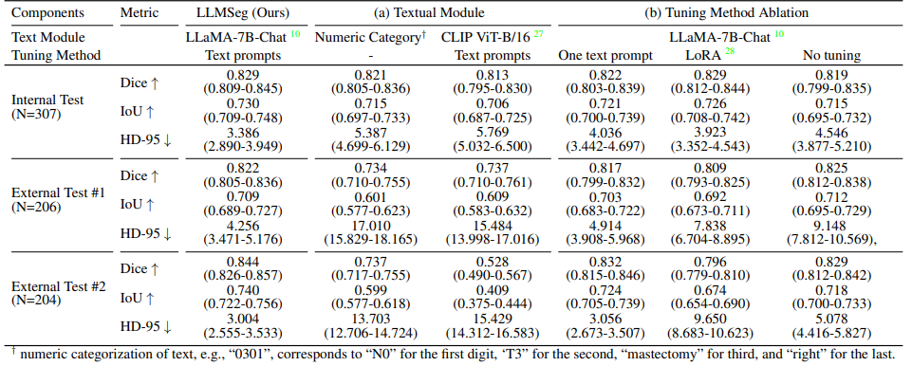
Results
Exploring Textual Clinical Information Provision Methods in the Multimodal Model
Numeric category
Internal: exhibited promising performance
External: performance gaps increased up to 0.1 in the Dice metric and 10 cm in the HD-95 metric
CLIP ViT-B/16
External: performance gaps increased up to 0.3 in the Dice metric and 10 cm in the HD-95 metric

Slide 20
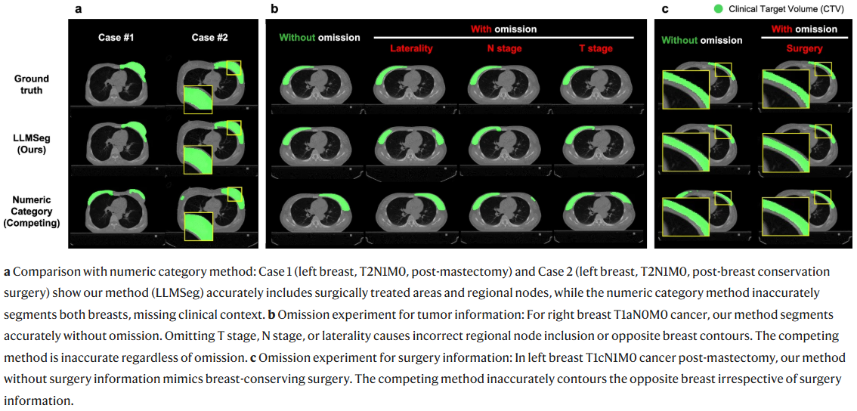
Results
Exploring Textual Clinical Information Provision Methods in the Multimodal Model
Case #1: total mastectomy, T2N1M0, left
Ours
include the breast and regional nodal area
Numeric
masks for both breasts (more mask on the opposite breast)
Case #2: BCS, T2N1M0, left
Ours
included breast and regional nodes while sparing the skin and chest wall
Numeric
Included breast
excluded regional nodes
included parts of the skin and chest wall

Slide 21
Results
Ablation Study of Input Clinical Data Components
Patient: BCS, T1aN0M0, right
Ours
Omission T stage: included regional nodes (higher T cases)
Omission N stage: included regional nodes (N1 or N2 cases)
Omission laterality: inaccurately contoured the opposite breast
Numeric
Without omission
Contouring on the opposite breast
little change in target contouring (laterality)
changed in patterns unrelated to the omitted information (T stage or N stage information)

Slide 22
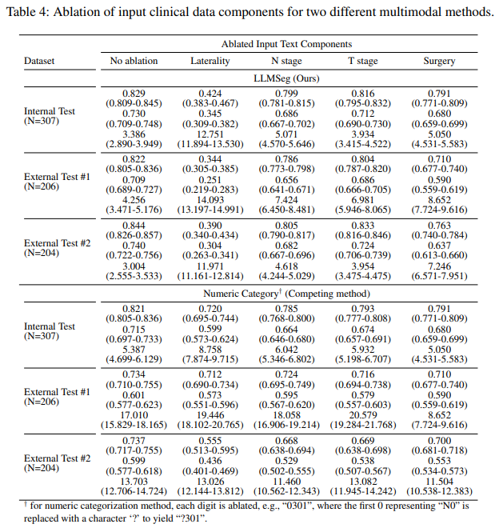
Results
Ablation Study of Input Clinical Data Components
Patient: Post-mastectomy, T1cN1M0, left
Ours
Omission Surgery: sparing the skin and chest wall (BCS)
Numeric
Omission Surgery: Contouring on the opposite breast
Table4
exclusion of laterality
exclusion of surgery type, exclusion of N stage
exclusion of T stage information
=> indicate that every component contributes to the model’s performance.

Slide 23
Results
Exploring Other Cancer Types
Prostate Cancer
notable performance gain of up to 0.05 in Dice metric through all the validation settings on MM approach
more than double the differences in total scores on external validation setting
significantly larger differences compared to vision model
delineation of the primary site (assessing prostate volume coverage, including the seminal vesicle)
the volume definition (evaluating regional node irradiation appropriateness)

Slide 24
Discussion
Models have been specifically designed and trained to excel in a singular task without the adaptability to transition across various tasks → lack the flexibility to navigate the complex challenges in the medical domain
Radiation oncology exemplifies a robust case for the adoption of multimodality in two fundamental factors.
Radiation Oncology extends beyond imaging to include clinical information which can be conveyed textually
(surgical notes, pathology reports, and electronic medical records)
Prior knowledge of standard treatment guidelines is vital for treatment decision-making
Our model accurately segmented radiation therapy target volume based on clinical information achieving absolute performance where the multimodal model surpasses the vision-only model
Clinical training of expert is placed on multimodality information of both images and text, facilitating the inference of text-image relationships and enabling effective learning
This aspect of the clinical learning paradigm aligns seamlessly with our proposed multimodal model

Slide 25
Discussion
The decrement in performance is due to variations in image acquisition settings and characteristics of devices
However, the ability of clinical experts is largely unaffected by external factors because the linguistic concepts embodied in textual clinical information are independent of such acquisition settings.
Our model which learns with such textual clinical information by leveraging the great linguistic capability of LLMs demonstrates particularly commendable performance in external validation settings.
This characteristic is particularly optimal for the medical domain where training data is limited and stable generalization performance is a prerequisite
Furthermore, we demonstrated the necessity of incorporating clinical information into target volume contouring, in cases where the segmentation may not be clearly visible in the planning CT image.

Slide 26
Limitations
Our evaluation is confined to patients at their initial diagnosis, leaving a scope for further exploration into varied patient scenarios and treatment stages.
The model does not consider radiation therapy doses in target volume contouring
dose-related variables could be integrated to enhance delineation and treatment planning in future studies.
While the model utilizes refined clinical data
future research can explore mechanisms for automating the data refinement process
further develop capabilities to process raw clinical data to reduce the need for manual intervention
Both breast and prostate cancers types are categorized as having relatively standardized target volume.
further validation of our method’s generalizability across a wider range of cancer types
We focuses CTV contouring but GTV delineation which involves contouring visually apparent areas is crucial in clinical practice due to its importance in boost techniques for increased dose administration
future studies should expand to encompass GTV contouring, thereby improving its clinical utility
Black-box nature of AI may hinder clinician’s direct utilization
model should provide explainable results such like confidence map in the clinical practice

Slide 27









Collaborators
Radiology
Joon Beom Seo, SangMin Lee^{A,B}
Dong Hyun, Yang, Hyung Jin Won
Ho Sung Kim, Seung Chai Jung
Ji Eun Park, So Jung Lee
Jeong Hyun Lee, Gilsun Hong
Pathology
Hyunjeong Go, Gyuheon Choi
Gyungyub Gong, Dong Eun Song
Cardiology
Jaekwan Song, Jongmin Song
Young-Hak Kim
Anesthesiology
Sung-Hoon Kim, Eun Ho Lee
Neurology
Dong-Wha Kang, Chongsik Lee
Jaehong Lee, Sangbeom Jun
Misun Kwon, Beomjun Kim
Surgery
Beom Seok Ko, JongHun Jeong
Songchuk Kim, Tae-Yon Sung
Internal Medicine
Jeongsik Byeon, Kang Mo Kim
Emergency Medicine
Dong-Woo Seo

